Slide 1

ALSET SOFTWARE DESIGN ALSET SORTWARE DESIGN
ALSET SOFTWARE
ALSET SOFTWARE DESIGN
Diego, Elizabeth, Melissa, Nusiba
ALSET SOFTWARE DESIGN
Notes:
need to change page numbers
the little text behind the textboxes
- table of contents update!!

Slide 2
ALSET SOFTWARE DIEGO LIZ NUSIBA MEL
— 02
Table of Contents
Hug the Lanes
01 — Goal, Use, Value
02 — Requirements
03 — Architecture
04 — Software Development Process
05 — Code
06 — Testing

Slide 3

ALSET SOFTWARE diego liz nusiba mel
— 03
GOAL, USE, & VALUE
Goal
Use
Value
Creating a safe, efficient, and comfortable self-driving car experience.
Providing the peace of mind of safety in all aspects. Allowing for a far more comfortable and enjoyable drive built for both a quick trip to the grocery store or a family roadtrip.
The value of this car lies in its ability to provide a safe and enjoyable driving experience for the passengers while taking care of their personal preferences.

Slide 4

ALSET SOFTWARE DIEGO LIZ NUSIBA MEL
REQUIREMENTS
— 04
ALSET SOFTWARE ALSET SOFTWARE
Functional:
Ensure vehicles are street-legal & safe
Lane-keeping assistance
Automatic braking
Cruise control
Stage 0-3 of automated operation: requiring a driver to assume legal responsibility
Non-Functional:
Improve the users's experience but are not technically required for safety and legality
GPS
Music & Talk integration
Automatic Seat Adjustments based on who the driver is
functional
non-functional
ALSET SOFTWARE
Notes:
liz
Safety and comfort are our biggest priorities for this vehicle. Currently it's in stages 0-3 of automated operation, which means that although the car is automated, a driver is required to be present and active. They will assume legal responsibility for everything the car does, relieving the manufacturer of that liability.

Slide 5
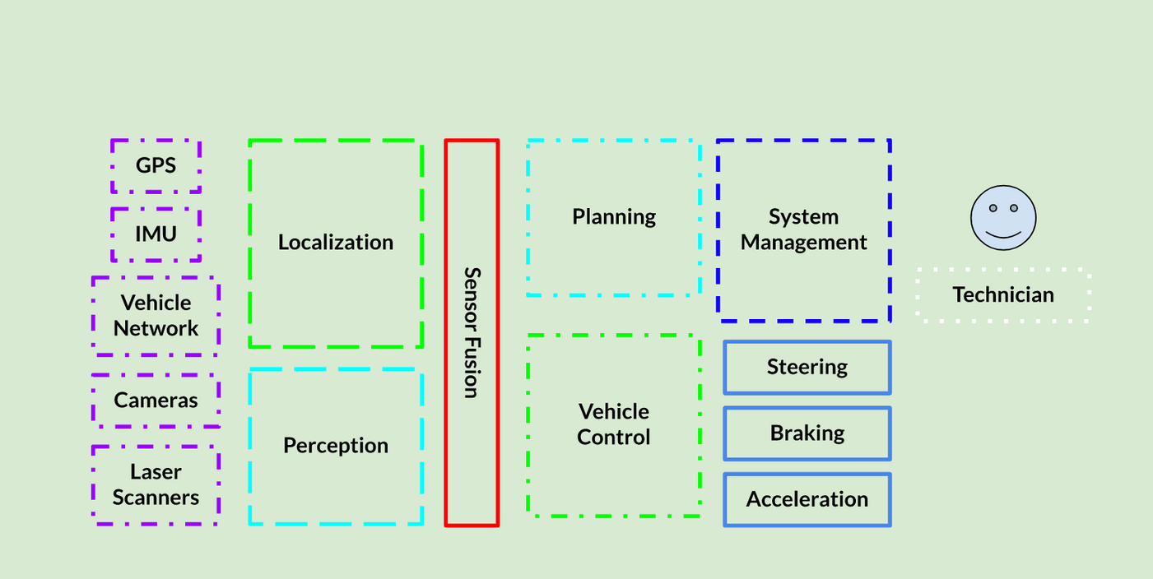
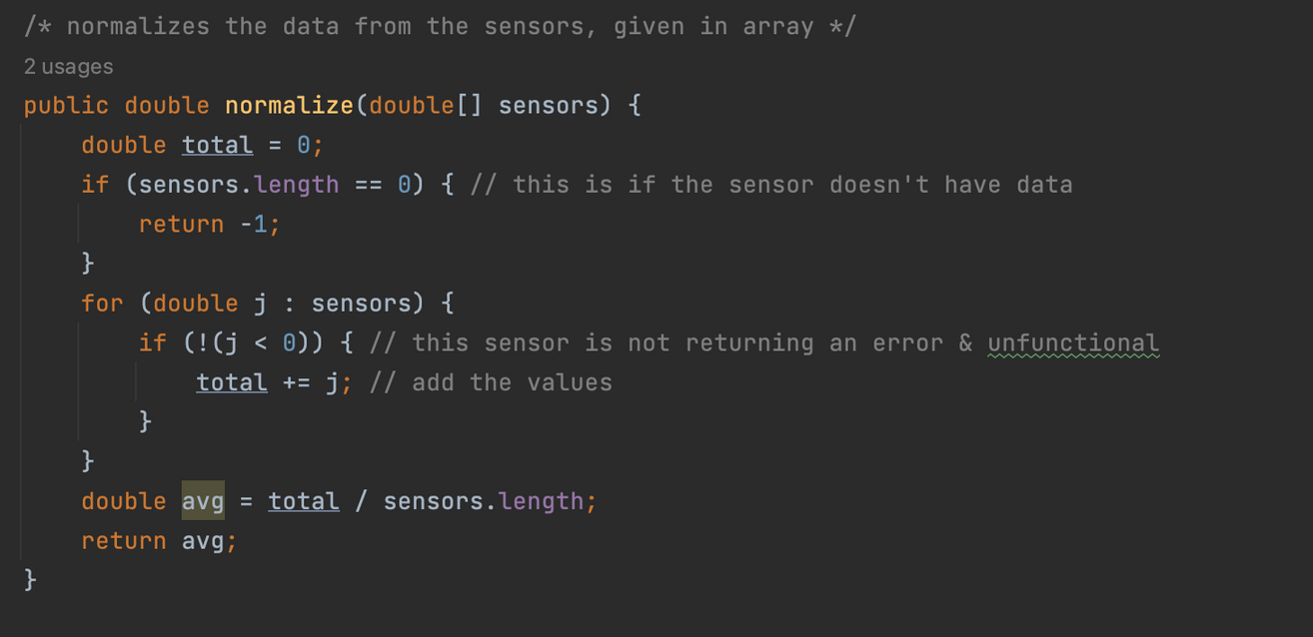

— 05
Architecture
The flow behind the software
Sensors update data measurements in this realtime system, sending them to sensor fusion, which normalizes it, then sends it to planning, which determines which changes must be made in for the car to continue moving safely. Queues are sent from Planning to Vehicle Control, where car activity is actually changed. The Technician Interface is separate and must be accessed via login when the car is off.
Notes:
The sensors connect to perception and localization which feed information to sensor fusion, which normalizes it then sends it to planning which tells vcs how to respond and react appropriatelyu

Slide 6
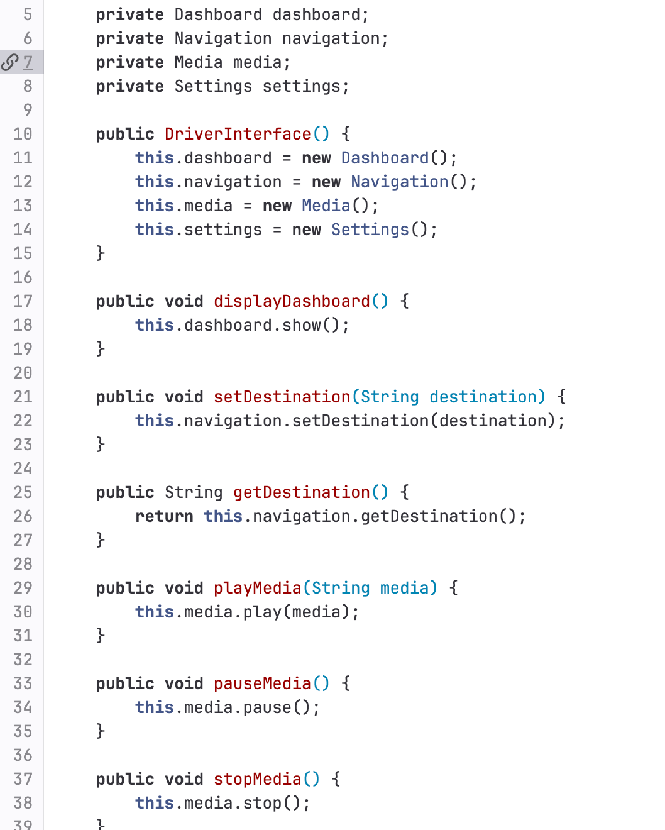
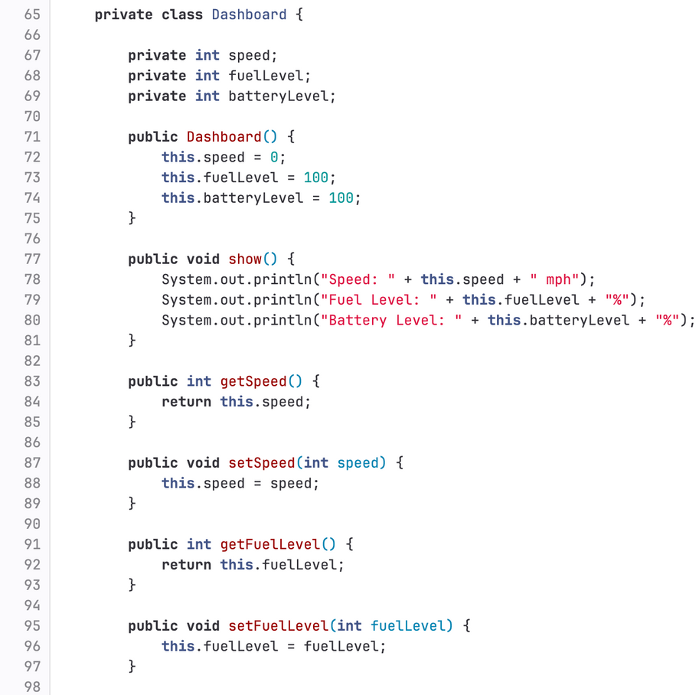
— 06
Driver Interface
Activates other classes
ex. Instantiates the dashboard class and uses it to display the media, and other states of the car, including speed and energy levels
Safely displays important information without distractions
Includes the non-functional requirement of playing music and seamlessly displaying its information
Notes:
liz
we update and present the dashboard information, only the essentials

Slide 7
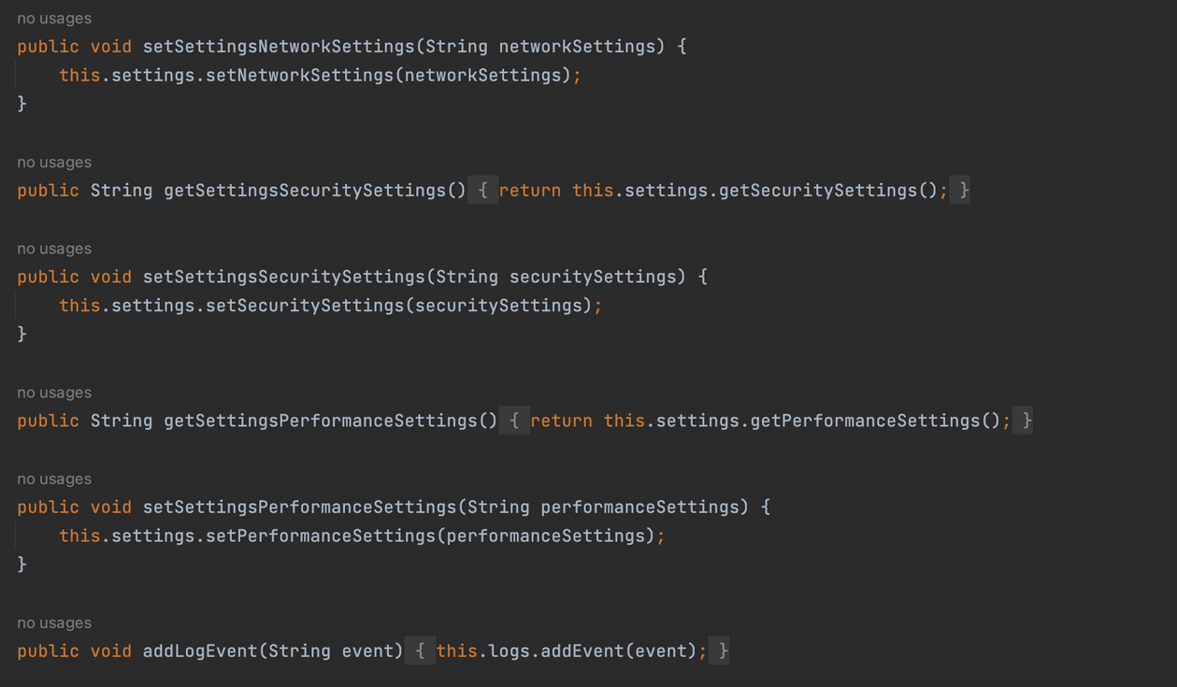
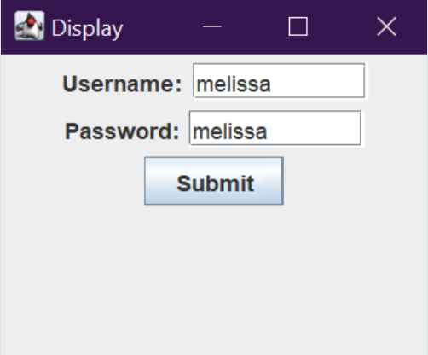
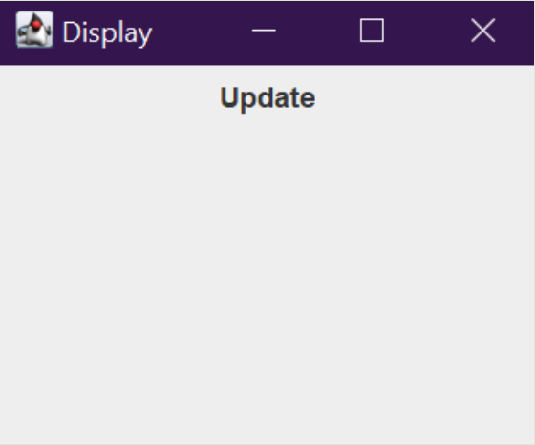
TECHNICIAN INTERFACE
ALSET SOFTWARE DIEGO LIZ NUSIBA MEL
— 07
Requires a login and password to ensure the driver cannot accidentally or intentionally override safety settings
The technician class above allows the technician to update and download events after they have happened, allowing for analysis of the way the car reacts under different conditions, helping us improve future iterations of the software
Updates are downloaded via wifi in a separate interface
Notes:
The technician class allows the technician to access log data and update the vehicle. It is protected behind a login
ex. we set the username and password to melissa; when entered properly the page to update the vehicle pops up and is available
--code??

Slide 8
— 08
VISUAL ARTS — EASTSIDE LEARNING ACADEMY
SOFTWARE
DEVELOPMENT
PROCESS
ensures a reliable safe product that is evolvable with more safety features in the future.

Slide 9
ALSET SOFTWARE diego liz nusiba mel
— 09
PROCESS
Overview
Requirements Gathering
Iterative and incremental development process
Focus on user requirements and safety features
Continuous testing and feedback loops
Emphasis on documentation and code quality
Agile development methodology
Identify user needs and expectations
Define software requirements based on user input
Analyze potential safety risks and mitigations
Define key performance indicators for safety and reliability

Slide 10
ALSET SOFTWARE diego liz nusiba mel
— 10
PROCESS
Architecture
Design
Service-oriented architecture chosen for scalability and flexibility
Detailed component-level design for each software component
User Interface, Data Management, Control, Communication, Security, and Network components defined
Emphasis on reliable and secure communication between components
Detailed design of each software component
Inputs, outputs, and operations of each component defined
User Interface, Data Management, Control, Communication, Security, and Network components defined
Ensures each component interacts with each other according to the software architecture

Slide 11
ALSET SOFTWARE diego liz nusiba mel
— 11
PROCESS
Testing
Evolvability
Comprehensive testing plan for each software component
Continuous integration and deployment with automated testing
User acceptance testing to ensure software meets user requirements
Code review and quality assurance to maintain code quality
Continuous improvement and feature development through user feedback and safety evaluations
Agile development methodology enables fast feature implementation and iteration
Emphasis on maintainability and updateability for future safety features
Design for future integration with emerging technologies such as autonomous vehicles.

Slide 12

ALSET SOFTWARE DIEGO LIZ NUSIBA MEL
— 12
REFELECTING ON THE ALSET PROJECT
our experience with the software development process and how we could improve in the future

Slide 13


ALSET SOFTWARE DIEGO LIZ NUSIBA MEL
— 13
The Software Development Experience
The Alset Hug the Lanes project allowed us to foster a better understanding what it means work collaboratively

Slide 14
VISUAL ARTS — EASTSIDE LEARNING ACADEMY
WHAT WORKED?
Collaboration and teamwork
Shared goals and responsibilities
Supportive and inclusive team culture
Synergy in skill sets and expertise
Documentation and knowledge sharing
Comprehensive documentation
Knowledge transfer within the team
Future reference and maintenance ease
— 14
Proper planning and organization
Well-defined project scope and objectives
Realistic timelines and milestones
Efficient resource allocation

Slide 15
ALSET SOFTWARE DIEGO LIZ NUSIBA MEL
— 15
What Didn't?
Insufficient testing and quality control
Lack of communication and misalignment
Our testing methods for our software felt inadequate and rushed for full scope of the project. The testing also didn't follow any kind of standard, leaving a lot of room for misunderstandings.
Team meetings were not as frequent as we would have liked which lead to a poor feedback loop. Tasks were also left quite vague which made it more difficult to align our ideas as we envisioned.
How would we improve in the future?

Slide 16

THANK YOU FOR LISTENING
Alset Software Design & Development

